Slide 1


Slide 2
What is ARRL Field Day?
Field Day is ham radio’s “open house”.
ARRL Field Day is a combined event to test our ability to setup radio communication under less than ideal conditions–think temporary antennas, generators and radio gear.
Every June, more than 40,000 hams throughout North America set up temporary transmitting stations in public places to demonstrate ham radio's science, skill and service to our communities and our nation.
It combines public service, emergency preparedness, community outreach, and technical skills all in a single event.
Field Day has been an annual event since 1933 and remains the most popular event in ham radio.

Slide 3
WHEN: June 27-28 (Saturday – Sunday)
WHERE: CARS fire station location
Clearwater Fire Station #48, 1700 N Belcher Rd., Clearwater, FL 33765, USA
SETUP begins: 8AM Saturday (lunch is around Noon)
OPERATE: 2PM Sat thru 2PM Sun
TEARDOWN: 2PM Sunday
UPARC, SPARC. WORMs & CARS joint event (and looking like a big turnout so far!)
Contest Callsign: W4TA
Operation will be Indoors (except for Satellite ops)
For sanitary reasons, we do not share headphones or microphone headsets
Please bring your own headset gear, must be wired and fit 3.5mm or 1/4in plugs
More Info – see UPARC website Field Day article (thanks Tom NY4I)
SIGNUP: www.uparc.org (please signup NLT June 20)
ANY UPDATES NEEDED?

Slide 4
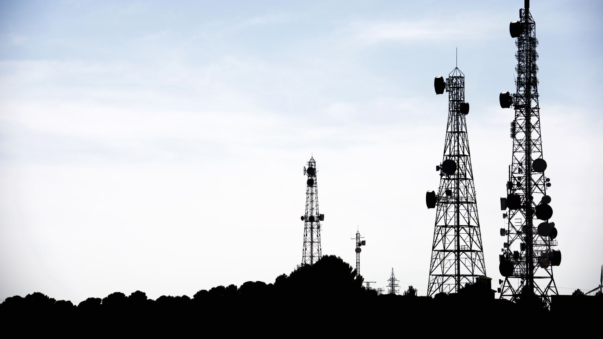
Operating Modes & Bands

Slide 5
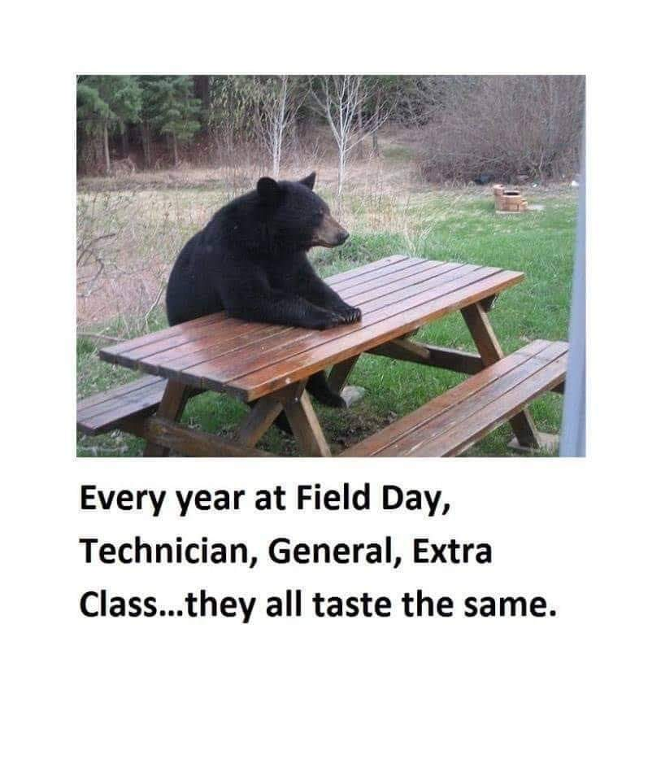
The following modes & bands are planned to be run at the 2025 ARRL Field Day event:
CW
SSB
FT8
6m – 80m

Slide 6
Station Gear

Slide 7
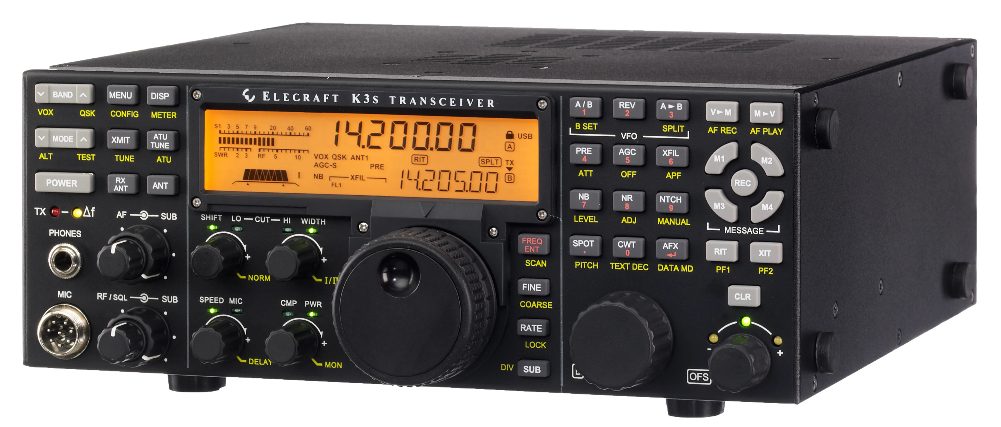
Radios to be used
Elecraft K3 #1 = SSB **
Elecraft K3S #2 = FT8 **
Elecraft K3 #3 = SSB or CW **
** - Primary mode of operation, will be capable of other modes if conditions dictate
ANY UPDATES NEEDED?

Slide 8
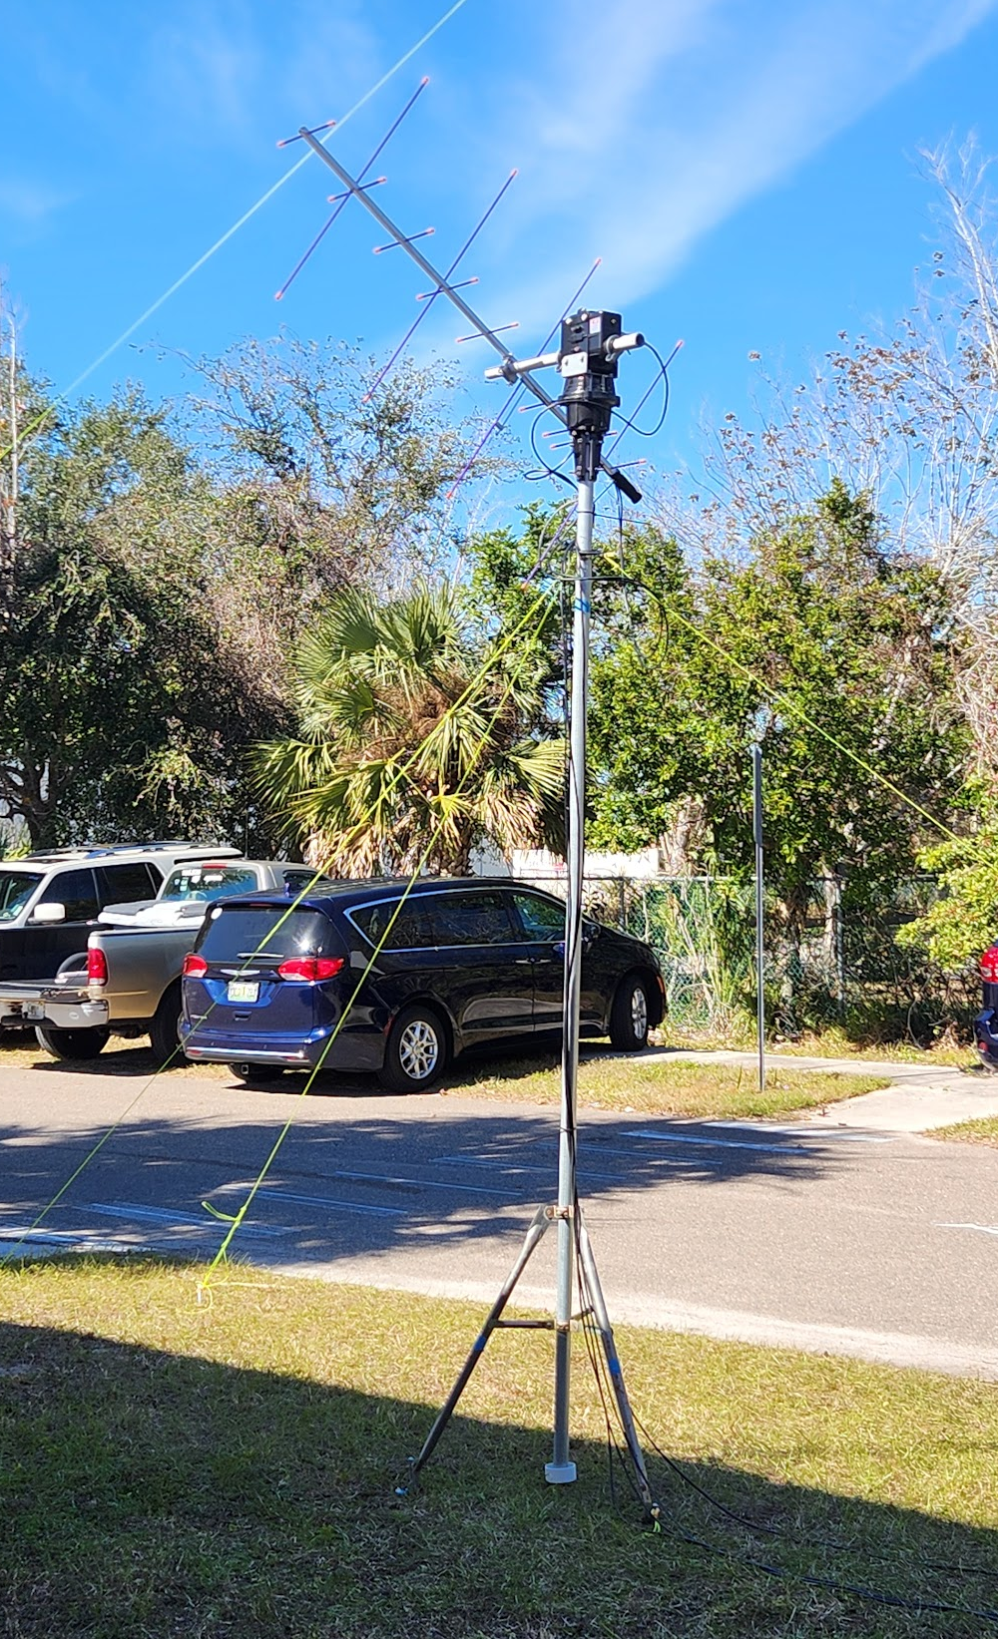
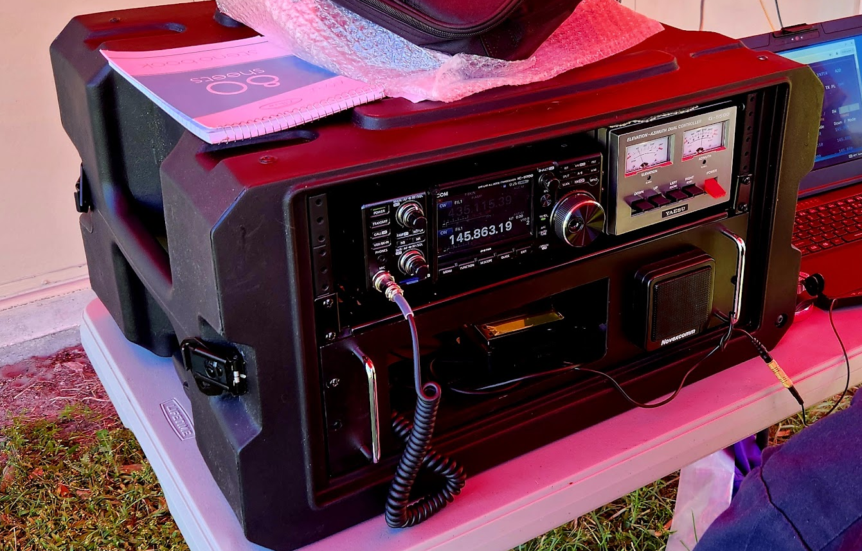
Satellite Station - ICOM 9700, Yaesu AZ/EL rotator, Arrow yagi antenna & SAT control device

Slide 9
Antennas Ryan AF4O

Slide 10
Hexbeam (20m, 15m, 10m)
OCF Dipole (80m – 6m) 132ft
ZS6BKW (80m – 10m)
Rollup J-pole (VHF/UHF) on 30ft push-up mast

Slide 11
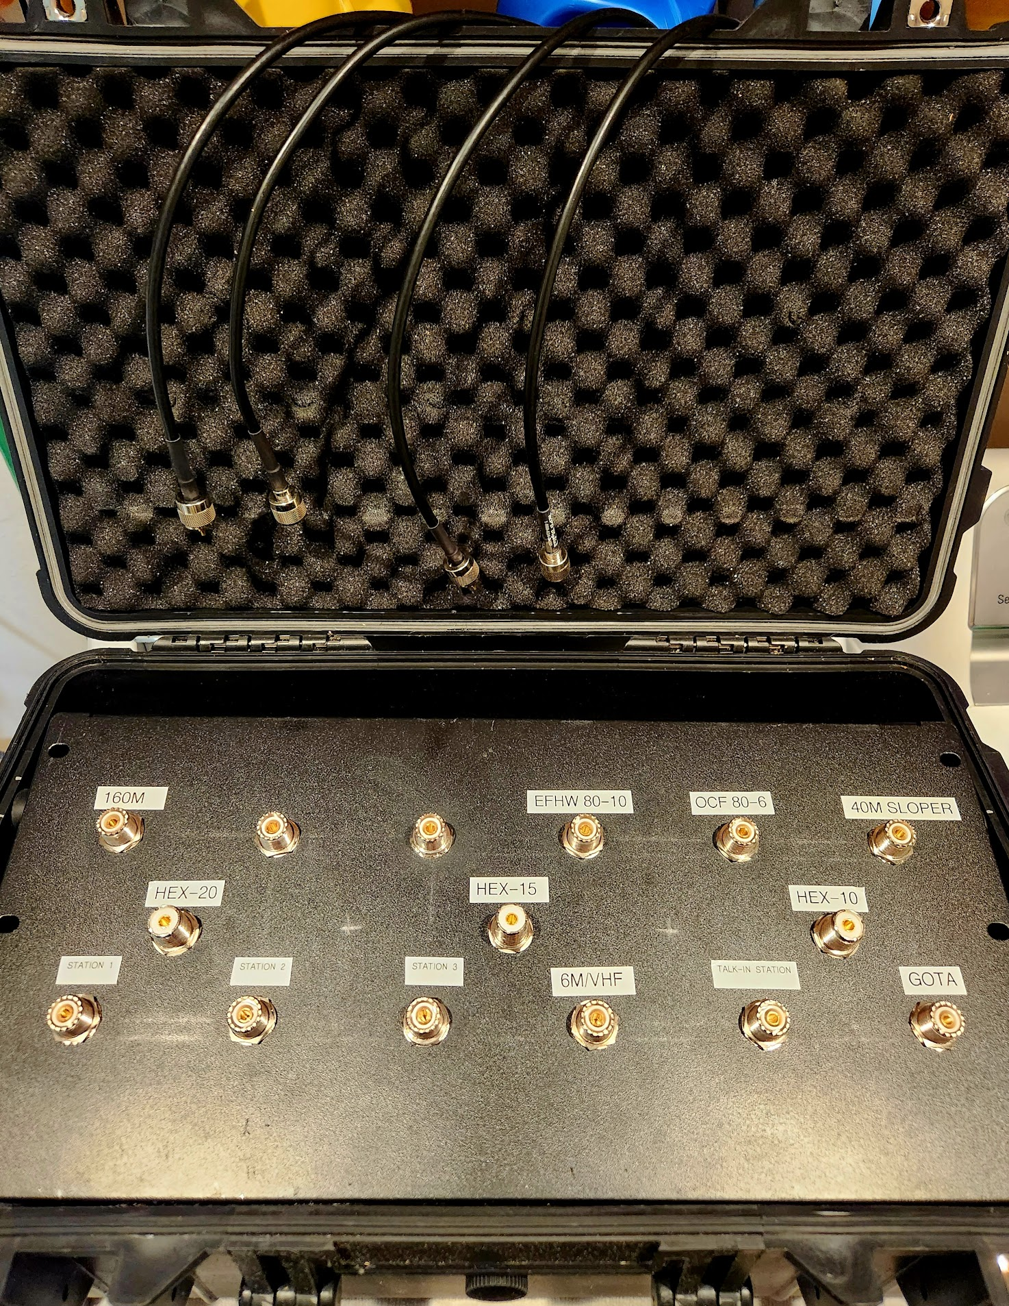
All antenna feedlines will come back to the radio room into this portable patch panel.
This is how the radios will be connected to various antennas.
Do NOT make any changes in coax configuration without approval from the assigned ‘Band Boss’.

Slide 12
Education Fred W2SUB

Slide 13
Field Day Education and Training Sessions
Welcome to Field Day – all Visitors
Ham Radio Basics
Ham Radio Awards & Achievements
How to build an EFHW kit antenna
How to use an Antenna Analyzer
ANY UPDATES NEEDED?
Training led by Fred W2SUB

Slide 14
6m Station

Slide 15
6 Meter Station
“6 meter Paul”
Paul KC4YDY will bring his dedicated 6m station back to Field Day this year

Slide 16
Fine Dining Ron W4RFA

Slide 17
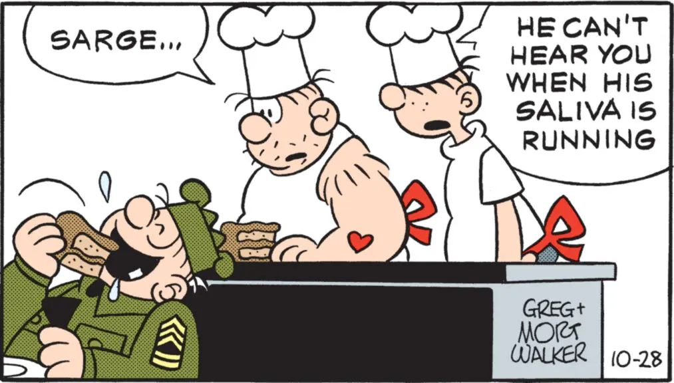
Saturday Breakfast = Donuts, Coffee
Saturday Lunch = Hamburgers and hotdogs, salad, chips, etc.
Saturday Dinner = TBD
Bring a side dish to share for Saturday dinner.
Sunday Breakfast = Bagels (Tom), coffee
Sunday Lunch = Leftovers
Water, tea and sodas provided the entire events
ANY UPDATES NEEDED?
NOTE: If you have any special or restrictive dietary needs, please make plans to provide that yourself

Slide 18
Contact Logging Tom NY4I TR4W Overview

Slide 19
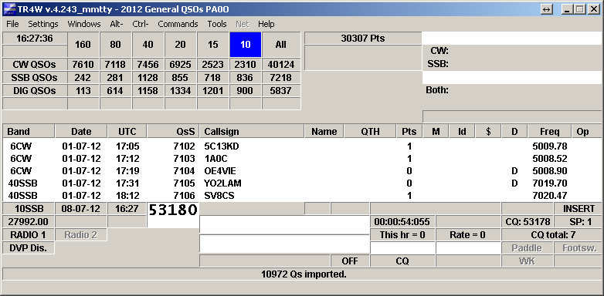
Contest logging will be done using the trusted TR4W
Each operating station will have a laptop running TR4W
Each station will be connected on an internal only network to sync and track all logged contacts
Don’t forget to “OPON” when starting your shift!
ANY UPDATES NEEDED?

Slide 20
Field Day Q&A

